Slide 1

CompSci 471
→
-1.9
→
9.6
→
16.1
+10
Artificial Intelligence
↓
-1.9
WALL
↓
-3.8
−10
Lesson 14: Reinforcement Learning II
Policy Iteration
→
-1.9
→
-1.9
→
-12.4
↑
-16.9
LOCK the arrows → update the numbers.
UNLOCK the arrows → choose better actions.
Same Gridworld. Different strategy.
Initialize
policy π₀
→
Evaluate V^{π}
↓
↓
Policy iteration loop
Stable?
→
Improve π
Fall 2026
CS 471 | L14: Policy Iteration
1
Notes:
Open by contrasting value iteration with policy iteration. Emphasize that the MDP model stays the same; the organization of computation changes.

Slide 2
Today’s mission
Policy and value give meaning to behavior over time.
1
Explain policy evaluation and policy improvement.
2
Apply a simple policy-iteration step.
3
Compare policy iteration and value iteration.
Performance target: given a current policy and evaluated action values, determine whether the policy should change and explain when policy iteration terminates.
CS 471 | L14: Policy Iteration
2
Notes:
Tie directly to the objectives. Emphasize that students should be able to identify phases, improve a policy from Q-values, and state the stopping condition.

Slide 3

Retrieval: what did value iteration do?
Value iteration repeatedly applied optimality backups.
-1.9
9.6
16.1
+10
Predict
↓
Evaluate
↓
Choose MAX
↓
Update V
$$Vₖ₊₁(s) = \max_{a}{ [R(s,a) + γ \sum{P(s′ | s,a)Vₖ(s′)}]}$$
-1.9
WALL
-3.8
−10
Think back
Why did the Bellman backup use MAX?
-1.9
-1.9
-12.4
-16.9
What did convergence look like?
Today
We solve the same MDP, but organize the work differently.
Value iteration mixes judging and choosing inside each backup.
CS 471 | L14: Policy Iteration
2
Notes:
Ask students what the MAX meant in value iteration and what convergence meant. Then introduce policy iteration as a more explicit evaluate/improve process.

Slide 4
A different strategy for the same MDP
Two methods use the same model, but structure the computation differently.
Value Iteration
Estimate values
↓
Immediately take MAX
↓
Update values
↓
Repeat
Policy Iteration
Choose policy
↓
Evaluate that policy
↓
Improve that policy
↓
Repeat
Same states, actions, transitions, rewards — different organization of the reasoning.
CS 471 | L14: Policy Iteration
3
Notes:
Use this slide to position value iteration and policy iteration as siblings rather than completely separate topics.

Slide 5
Start with a policy — not with optimal values
Policy iteration begins with behavior that may or may not be good.
→
→
→
+10
Question
Is this policy optimal?
Answer
We do not know yet.
First we evaluate it.
↓
WALL
↓
−10
→
→
→
↑
The arrows specify the current policy.
Policy iteration starts by asking: “How good is the behavior I already have?”
CS 471 | L14: Policy Iteration
5
Notes:
Stress that policy evaluation estimates values under the current policy, not the optimal policy.

Slide 6
The arrows are the current policy
A policy maps each state to an action.
π(s) = a
→
→
→
+10
Policy
A rule for what to do in each state
Not a single action (“East” is one choice)
Tells us what to do whenever each state is reached
↓
WALL
↓
−10
→
→
→
↑
If the world is uncertain, the policy still tells the agent what to do after the outcome occurs.
CS 471 | L14: Policy Iteration
6

Slide 7
Policy evaluation asks one question
How good is this behavior if we keep following it?
V^{π}(s)
→
-1.9
→
9.6
→
16.1
+10
Meaning
↓
-1.9
WALL
↓
-3.8
−10
Expected cumulative discounted return starting in state s and following policy π.
Important
→
-1.9
→
-1.9
→
-12.4
↑
-16.9
We are not yet searching for a better action.
Evaluation judges the current arrows.
It does not change the arrows.
CS 471 | L14: Policy Iteration
7

Slide 8
LOCK THE POLICY
During policy evaluation, the arrows do not move.
→
0.0
→
0.0
→
0.0
+10
What can change?
The value estimates in the cells.
POLICY LOCKED
DURING EVALUATION
↓
0.0
WALL
↓
0.0
−10
What cannot change yet?
The action arrows selected by π.
→
0.0
→
0.0
→
0.0
↑
0.0
Evaluation changes the numbers — not the behavior.
CS 471 | L14: Policy Iteration
8

Slide 9
Tiny math retrieval
Same expected-value operation as L13; a different action-selection rule.
Next state
Probability
Value
X
0.80
5
Y
0.20
1
0.8(5) + 0.2(1) = 4.2
Today’s difference
We only evaluate the action specified by the current policy.
Same arithmetic. Different question: “How good is this policy?”
CS 471 | L14: Policy Iteration
9
Notes:
Spend about 60–90 seconds. The goal is retrieval, not a new probability lesson.

Slide 10
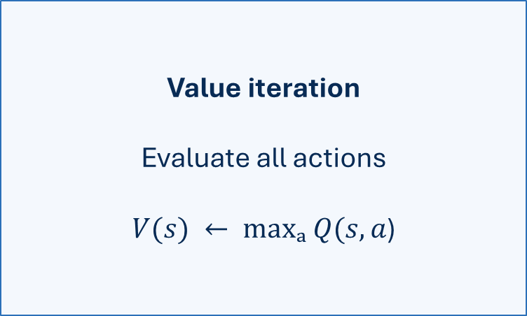
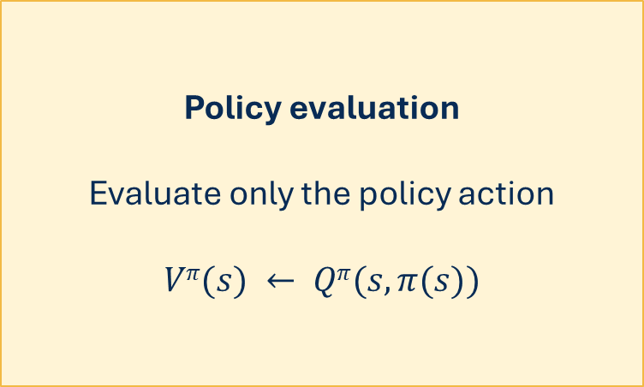
Value iteration versus policy evaluation
The MAX moves to a different phase.
Value iteration
Evaluate all actions
$V(s) ← maxₐ Q(s,a$)
Policy evaluation
Evaluate only the policy action
$$Vπ(s) ← Qπ(s, π(s))$$
Evaluation asks “How good is what I currently do?” — not “What should I do instead?”
CS 471 | L14: Policy Iteration
10
Notes:
This is the main mathematical distinction. The MAX appears during policy improvement, not during deterministic policy evaluation.

Slide 11
Why there is no MAX here
A deterministic policy has already selected the action to evaluate.
During evaluation
Only the current policy action is active.
If π(s)=North, evaluate North.
N
4.8
W
3.2
s
E
6.1
Later, during improvement
We will compare action values and may change the arrow.
S
2.7
current: N
The other actions are alternatives — but they are not selected during fixed-policy evaluation.
CS 471 | L14: Policy Iteration
11

Slide 12
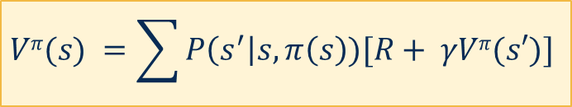
Evaluation backup: one state
Use the policy action and current successor values.
Policy action
π(s) = East
$$Vπ(s) =\sum{P\left(s^{′}\right|s, π\left(s\right))[R+ γVπ(s′)}]$$
→
-1.0
→
-1.0
→
15.0
+10
↓
-1.0
WALL
↓
-2.8
−10
Outcomes
→
-1.0
→
-1.0
→
-1.0
↑
-15.4
0.8 → intended cell
Key phrase
under the current policy
0.1 → slip north/stay
0.1 → slip south
We are estimating what happens if the agent keeps behaving according to π.
CS 471 | L14: Policy Iteration
12

Slide 13
Compute → Interpret → Predict
Every policy-evaluation number needs meaning.
V^{π}(s) = 5.0
Compute
The backup returned a value estimate of 5.0 for this state.
Interpret
5.0 is not an immediate reward. It is expected long-term return under π.
Predict
If successor-state values increase next sweep, this estimate may increase too.
Policy evaluation is about the value of continuing to follow this behavior.
CS 471 | L14: Policy Iteration
13

Slide 14
One backup is not policy evaluation
Policy evaluation repeats backups until values stabilize under the fixed policy.
One evaluation backup
Update one state’s estimate using the current policy action.
Policy evaluation
Repeatedly update values for the policy until the estimates are stable enough.
The policy stays fixed while value information propagates through the grid.
CS 471 | L14: Policy Iteration
14

Slide 15
Evaluation Sweep 0
Initial estimates under the locked policy.
→
0.0
→
0.0
→
0.0
+10
↓
0.0
WALL
↓
0.0
−10
POLICY LOCKED
→
0.0
→
0.0
→
0.0
↑
0.0
At the start, zero means initial estimate — not true value.
CS 471 | L14: Policy Iteration
15
Notes:
Walk students through this evaluation backup.

Slide 16
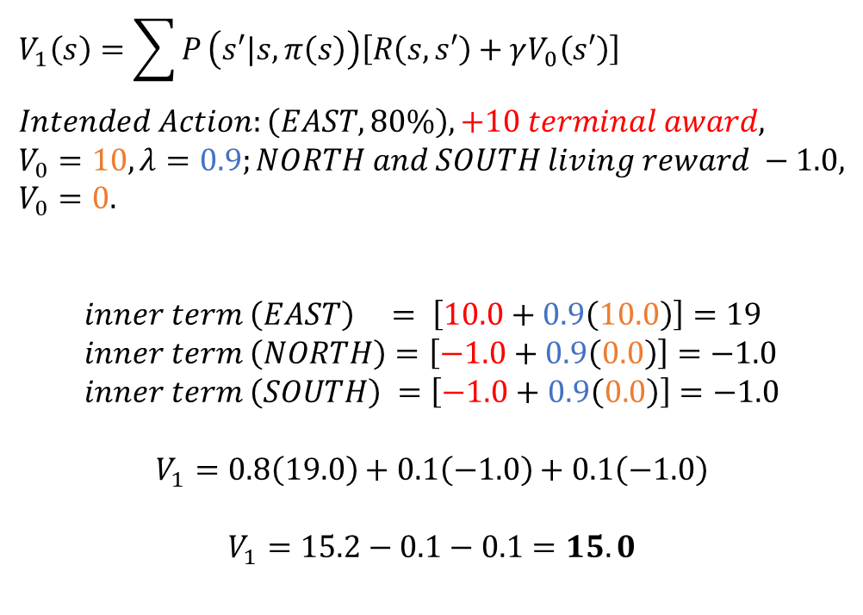
Evaluation Sweep 1 (closet to reward)
Values change. Arrows stay fixed.
$$V_{1}\left(s\right)=\sum{P}\left(s′|s,π\left(s\right)\right)\left[R\left(s,s′\right)+γV_{0}\left(s′\right)\right] \\ Intended Action:\left(EAST, 80\%\right), +10 terminal award, \\ V_{0}=10, λ=0.9;NORTH and SOUTH living reward −1.0, \\ V_{0}=0.$$
$$inner term \left(EAST\right) = \left[10.0+0.9\left(10.0\right)\right]=19 \\ inner term \left(NORTH\right)=\left[−1.0+0.9\left(0.0\right)\right]=−1.0 \\ inner term \left(SOUTH\right) =\left[−1.0+0.9\left(0.0\right)\right]=−1.0$$
$$V_{1}=0.8\left(19.0\right)+0.1\left(−1.0\right)+0.1\left(−1.0\right)$$
$$V_{1}=15.2−0.1−0.1=15.0$$
→
-1.0
→
-1.0
→
15.0
+10
↓
-1.0
WALL
↓
-2.8
−10
→
-1.0
→
-1.0
→
-1.0
↑
-15.4
POLICY LOCKED
The current policy begins to reveal which states lead toward good or bad outcomes.
CS 471 | L14: Policy Iteration
16

Slide 17
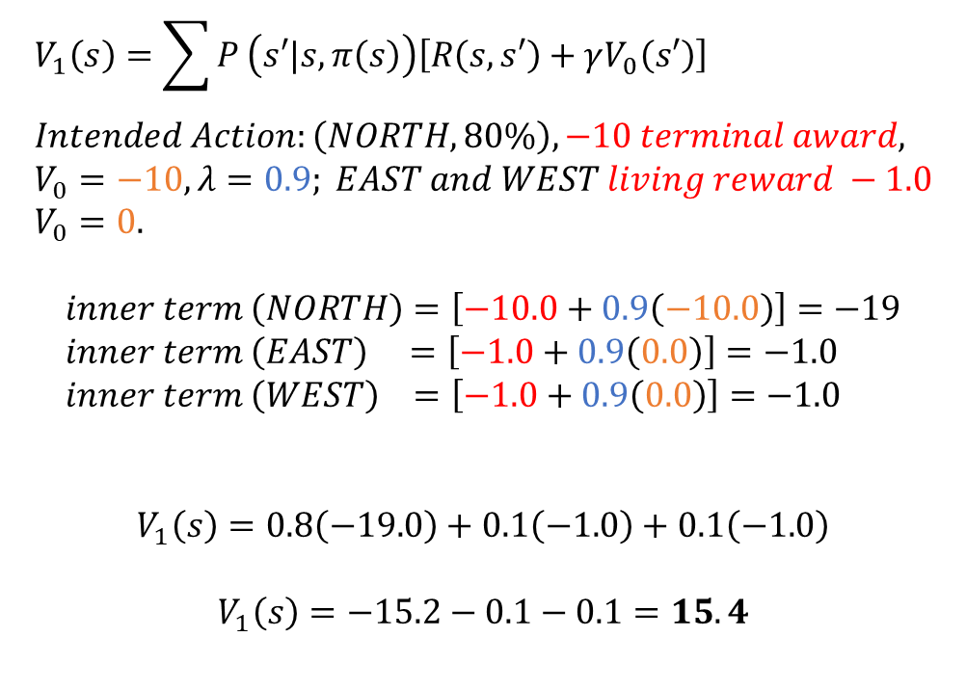
Evaluation Sweep 1 (bottom right)
Values change. Arrows stay fixed.
$$V_{1}\left(s\right)=\sum{P}\left(s′|s,π\left(s\right)\right)\left[R\left(s,s′\right)+γV_{0}\left(s′\right)\right] \\ Intended Action:\left(NORTH, 80\%\right), −10 terminal award, \\ V_{0}=−10, λ=0.9; EAST and WEST living reward −1.0 \\ V_{0}=0.$$
$$inner term \left(NORTH\right)=\left[−10.0+0.9\left(−10.0\right)\right]=−19 \\ inner term \left(EAST\right) =\left[−1.0+0.9\left(0.0\right)\right]=−1.0 \\ inner term \left(WEST\right) =\left[−1.0+0.9\left(0.0\right)\right]=−1.0$$
$$V_{1}\left(s\right)=0.8\left(−19.0\right)+0.1\left(−1.0\right)+0.1\left(−1.0\right)$$
$$V_{1}\left(s\right)=−15.2−0.1−0.1=15.4$$
→
-1.0
→
-1.0
→
15.0
+10
↓
-1.0
WALL
↓
-2.8
−10
→
-1.0
→
-1.0
→
-1.0
↑
-15.4
POLICY LOCKED
The current policy begins to reveal which states lead toward good or bad outcomes.
CS 471 | L14: Policy Iteration
16

Slide 18
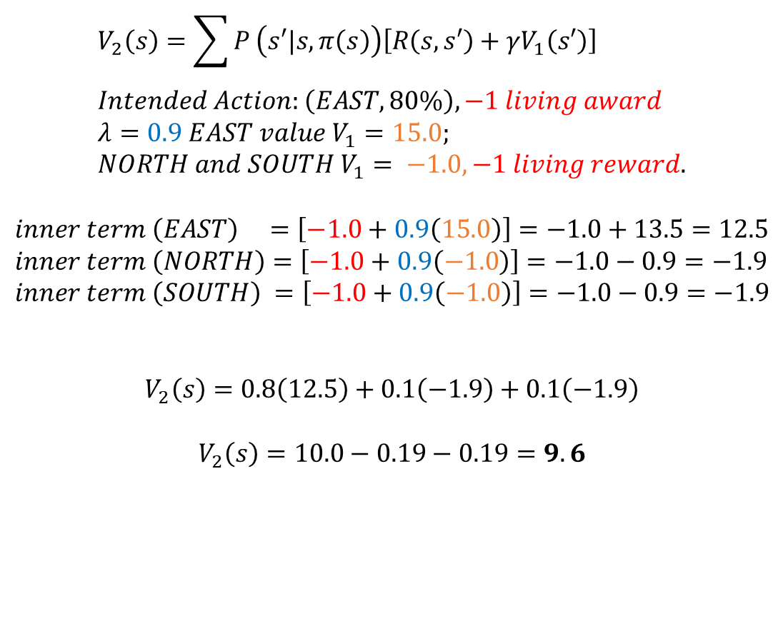
Evaluation Sweep 2
More long-term consequences are reflected in the numbers.
$$V_{2}\left(s\right)=\sum{P}\left(s′|s,π\left(s\right)\right)\left[R\left(s,s′\right)+γV_{1}\left(s′\right)\right] \\ Intended Action:\left(EAST, 80\%\right), −1 living award \\ λ=0.9 EAST value V_{1}=15.0; \\ NORTH and SOUTH V_{1}= −1.0, −1 living reward.$$
$$inner term \left(EAST\right) =\left[−1.0+0.9\left(15.0\right)\right]=−1.0+13.5=12.5 \\ inner term \left(NORTH\right)=\left[−1.0+0.9\left(−1.0\right)\right]=−1.0−0.9=−1.9 \\ inner term \left(SOUTH\right) =\left[−1.0+0.9\left(−1.0\right)\right]=−1.0−0.9=−1.9$$
$$V_{2}\left(s\right)=0.8\left(12.5\right)+0.1\left(−1.9\right)+0.1\left(−1.9\right)$$
$$V_{2}\left(s\right)=10.0−0.19−0.19=9.6$$
→
-1.9
→
9.6
→
16.1
+10
↓
-1.9
WALL
↓
-3.8
−10
→
-1.9
→
-1.9
→
-12.4
↑
-16.9
POLICY LOCKED
The current policy begins to reveal which states lead toward good or bad outcomes.
CS 471 | L14: Policy Iteration
17

Slide 19
Why multiple sweeps?
Values depend on successor values, which may still be changing.
A
B
C
+10
Sweep pattern
C learns about the terminal reward.
Then B can use C.
Then A can use B.
Key idea
Even fixed behavior can require repeated value backups.
Evaluation propagates long-term consequences through the locked policy.
CS 471 | L14: Policy Iteration
18

Slide 20
Evaluation changes numbers — not behavior
Same arrows, evolving value estimates.
→
0.0
→
0.0
→
0.0
+10
→
-1.0
→
-1.0
→
15.0
+10
→
-1.9
→
9.6
→
16.1
+10
→
5.6
→
12.3
→
16.1
+10
↓
0.0
WALL
↓
0.0
−10
↓
-1.0
WALL
↓
-2.8
−10
↓
-1.9
WALL
↓
-3.8
−10
↓
-2.7
WALL
↓
-12.1
−10
→
0.0
→
0.0
→
0.0
↑
0.0
→
-1.0
→
-1.0
→
-1.0
↑
-15.4
→
-1.9
→
-1.9
→
-12.4
↑
-16.9
→
-2.7
→
-10.3
→
-14.6
↑
-18.0
V₀
V₁
V₂
later
The action arrows stay locked throughout evaluation.
CS 471 | L14: Policy Iteration
19

Slide 21
Now unlock the policy
Once values are stable enough, we ask whether to change behavior.
→
5.6
→
12.3
→
16.1
+10
↓
-2.7
WALL
↓
-12.1
−10
UNLOCK
FOR IMPROVEMENT
New question
Is another action better in any state?
→
-2.7
→
-10.3
→
-14.6
↑
-18.0
Evaluation gave us numbers. Improvement uses them to reconsider the arrows.
CS 471 | L14: Policy Iteration
20

Slide 22
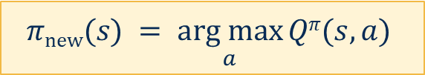
Policy improvement asks: can I do better here?
Now we compare action values at a state.
N
4.8
Improvement phase
Consider the available actions and choose the largest estimated long-term value.
W
3.2
s
E
6.1
S
2.7
$$πnew(s) = \underset{a}{arg max}{Qπ(s,a)}$$
current: N
Improvement chooses the greedy action according to the evaluated values.
CS 471 | L14: Policy Iteration
21

Slide 23
Improvement chooses the greedy action
Find the highest action value.
N
4.8
Largest Q-value
East has the largest action value: 6.1
W
3.2
s
E
6.1
Improved action
π_{new}(s) = East
S
2.7
current: N
We are no longer evaluating the old arrow; we are choosing the best arrow.
CS 471 | L14: Policy Iteration
22

Slide 24
Sometimes the arrow changes
Improvement can replace a current action.
N
4.8
N
4.8
W
3.2
s
E
6.1
W
3.2
s
E
6.1
S
2.7
S
2.7
current: N
current: E
North → East because East gives the largest estimated long-term return.
CS 471 | L14: Policy Iteration
23

Slide 25
Sometimes the arrow stays exactly where it is
Policy improvement does not require a change.
N
7.0
Greedy action
North is already the largest value.
W
3.2
s
E
5.8
Conclusion
Improvement happened, but this state’s policy entry stays North.
S
2.1
current: N
Rule: choose the greedy action — not “always change the action.”
CS 471 | L14: Policy Iteration
24

Slide 26
The memory cue
Evaluation changes values. Improvement changes actions.
→
-1.9
→
9.6
→
16.1
+10
→
5.6
→
12.3
→
16.1
+10
↓
-1.9
WALL
↓
-3.8
−10
↑
-2.7
WALL
↑
-12.1
−10
→
-1.9
→
-1.9
→
-12.4
↑
-16.9
↑
-2.7
←
-10.3
←
-14.6
↓
-18.0
LOCKED policy
UNLOCKED policy
Arrows stay fixed.
Cell values change.
Values guide decisions.
Arrows may change.
LOCK arrows → update numbers. UNLOCK arrows → choose better actions.
CS 471 | L14: Policy Iteration
25

Slide 27
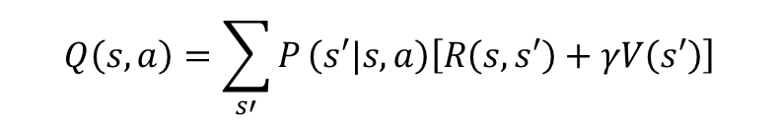
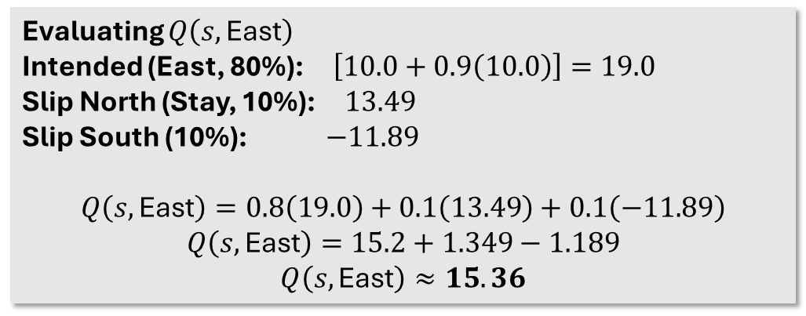
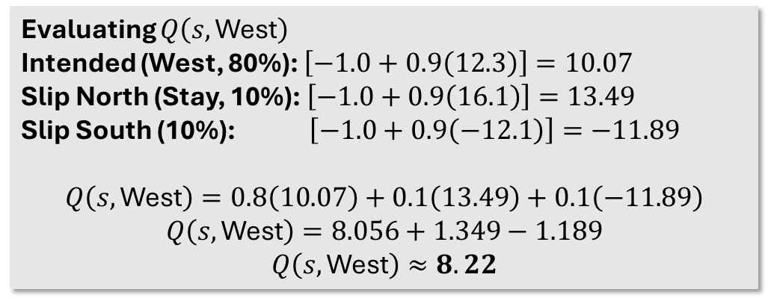
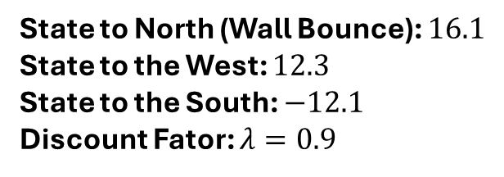
Why did the policy not change → to ← ?
Evaluation changes values. Improvement changes actions.
$$Q\left(s,a\right)=\sum_{s′}{P}\left(s′|s,a\right)\left[R\left(s,s′\right)+γV\left(s′\right)\right]$$
→
5.6
→
12.3
→
16.1
+10
Evaluating $Q\left(s,\text{West}\right)$
Intended (West, 80%): $\left[−1.0+0.9\left(12.3\right)\right]=10.07$
Slip North (Stay, 10%):$\left[−1.0+0.9\left(16.1\right)\right]=13.49$
Slip South (10%): $\left[−1.0+0.9\left(−12.1\right)\right]=−11.89$
$$Q\left(s,\text{West}\right)=0.8\left(10.07\right)+0.1\left(13.49\right)+0.1\left(−11.89\right)$$
$$Q\left(s,\text{West}\right)=8.056+1.349−1.189$$
$$Q\left(s,\text{West}\right)≈8.22$$
↑
-2.7
WALL
↑
-12.1
−10
↑
-2.7
←
-10.3
←
-14.6
↓
-18.0
State to North (Wall Bounce): $16.1$
State to the West: $12.3$
State to the South: $−12.1$
Discount Fator: $λ=0.9$
Evaluating $Q\left(s,\text{East}\right)$
Intended (East, 80%): $\left[10.0+0.9\left(10.0\right)\right]=19.0$
Slip North (Stay, 10%): $13.49$
Slip South (10%):$−11.89$
$$Q\left(s,\text{East}\right)=0.8\left(19.0\right)+0.1\left(13.49\right)+0.1\left(−11.89\right)$$
$$Q\left(s,\text{East}\right)=15.2+1.349−1.189$$
$$Q\left(s,\text{East}\right)≈15.36$$
CS 471 | L14: Policy Iteration
25

Slide 28
One complete policy-iteration cycle
A policy becomes a value estimate, then an improved policy.
→
→
→
+10
→
5.6
→
12.3
→
16.1
+10
→
→
→
+10
↓
WALL
↓
−10
↓
-2.7
WALL
↓
-12.1
−10
↑
WALL
↑
−10
→
→
→
↑
→
-2.7
→
-10.3
→
-14.6
↑
-18.0
↑
←
←
↓
π₀
evaluate π₀
π₁
Policy iteration alternates: evaluate the current policy, then improve it.
CS 471 | L14: Policy Iteration
26

Slide 29
Then do it again
The improved policy becomes the new current policy.
Start π₀
Evaluate V^π₀
Improve to π₁
Evaluate V^π₁
Improve again
→
→
→
→
State
π₀
π₁
Decision point
A
Charge
Maintain
Because at least one action changed, the new policy must be evaluated next.
B
Maintain
Maintain
C
Shed
Shed
The loop continues until improvement produces no changes.
CS 471 | L14: Policy Iteration
27
Notes:
Present a complete cycle with small tables. The goal is seeing the alternation rather than performing lots of arithmetic.

Slide 30
When do we stop?
Policy iteration terminates when the policy is stable.
→
→
→
+10
→
→
→
+10
↑
WALL
↑
−10
↑
WALL
↑
−10
↑
←
←
↓
↑
←
←
↓
No arrows changed → policy stable → stop.
CS 471 | L14: Policy Iteration
28
Notes:
This is the termination condition assessed in the module. Make sure students use “policy stops changing,” not “rewards become zero.”

Slide 31
Policy stability is different from value convergence
Different algorithms use different stopping signals.
Value Iteration
Stop when value estimates change by less than a tolerance.
Δ is small.
Policy Iteration
Stop when improvement produces the same policy.
No arrows changed.
VI watches the numbers. PI watches the arrows.
CS 471 | L14: Policy Iteration
29
Notes:
Make this comparison explicit to prevent students from overapplying the value iteration convergence idea.

Slide 32
VI vs. PI: same ingredients, different organization
Both use model-based Bellman reasoning.
Value Iteration
V₀ → Bellman optimality backup → V₁
MAX occurs inside each backup.
Policy Iteration
π₀ → evaluate π₀ → improve → π₁
MAX occurs during improvement.
VI mixes judging and choosing. PI separates judging from choosing.
CS 471 | L14: Policy Iteration
30

Slide 33
Where does MAX happen?
The placement of MAX tells the story.
Value Iteration
For every backup:
possible actions → MAX → updated V
Policy Iteration
Evaluation:
follow π only
Improvement:
compare actions → MAX → new π
No MAX during evaluation of a fixed deterministic policy.
CS 471 | L14: Policy Iteration
31

Slide 34
Both are model-based
Policy iteration still needs the MDP model.
States
Actions
Transition
probabilities
Rewards
Needed for evaluation
P(s′|s,a) and R determine the expected return under the policy.
Next question
What if those transition probabilities are unknown?
This sets up Q-learning: learning from experience instead of a known model.
CS 471 | L14: Policy Iteration
32
Notes:
Set up L15

Slide 35
Practice: policy-improvement sprint
Use evaluated action values to improve the policy.
State
Current action
Q(Hold)
Q(Charge)
Improved action
Tasks
1. Fill in the improved action.
2. Identify which states changed.
3. Decide whether the policy is stable.
P
Hold
4
6
____
Q
Charge
7
5
____
R
Hold
3
2
____
Improvement chooses the highest action value at each state.
CS 471 | L14: Policy Iteration
33
Notes:
Have students work in pairs. Expected improved policy: P→Charge, Q→Hold, R→Hold. Then ask whether the policy changed and whether the algorithm is finished.

Slide 36
Mini cycle: are we done?
Compare the current policy to the improved policy.
Current policy
P → Hold
Q → Charge
R → Hold
After improvement
P → Charge
Q → Hold
R → Hold
Question
Is the policy stable?
What happens next?
If any action changes, the new policy must be evaluated.
CS 471 | L14: Policy Iteration
34

Slide 37
Practice: diagnose the mistake
Label each statement as correct or incorrect.
Statement
Answer
Policy evaluation finds the optimal policy.
Incorrect
The evaluation phase of a fixed deterministic policy uses MAX over actions.
Incorrect
The Improvement phase must always change the action.
Incorrect
Policy iteration stops when no policy entries change.
Correct
The most common errors confuse evaluation with improvement.
CS 471 | L14: Policy Iteration
35

Slide 38
Read policy iteration
Map each part of the pseudocode to a visual phase.
LOCK
evaluate
UNLOCK
improve
changed?
choose initial policy π
repeat:
evaluate π
stable = true
for each state s:
old = π(s)
π(s) = best action using V^{π}
if π(s) != old:
stable = false
until stable
Questions
Which lines evaluate?
Which lines improve?
Why save old?
What causes termination?
The loop ends only when the improvement pass makes no changes.
CS 471 | L14: Policy Iteration
36

Slide 39
Exit ticket: rebuild policy iteration
Complete the two-phase story.
Policy evaluation
Policy improvement
Keep __________ fixed and estimate __________.
Choose the __________ action using the evaluated values.
If at least one action changes
______________________________.
If no actions change
______________________________.
One-sentence comparison
How does policy iteration differ from value iteration?
Next: What if we do not know the transition probabilities at all?
CS 471 | L14: Policy Iteration
37
Notes:
Collect or use as retrieval. Expected answers: policy fixed; Vπ; best/highest-valued; evaluate the new policy; terminate; explain VI vs PI difference.

